Slide 1
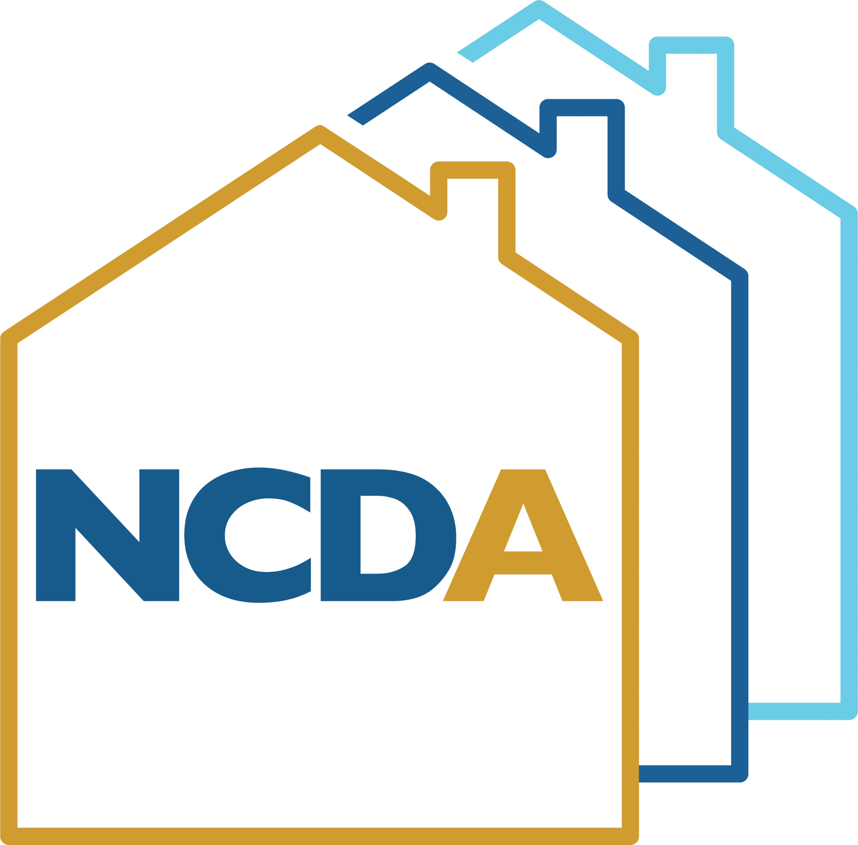
Using State and Local Fiscal Recovery Funds for Affordable Housing
NCDA Annual Conference
June 23, 2022

Slide 2
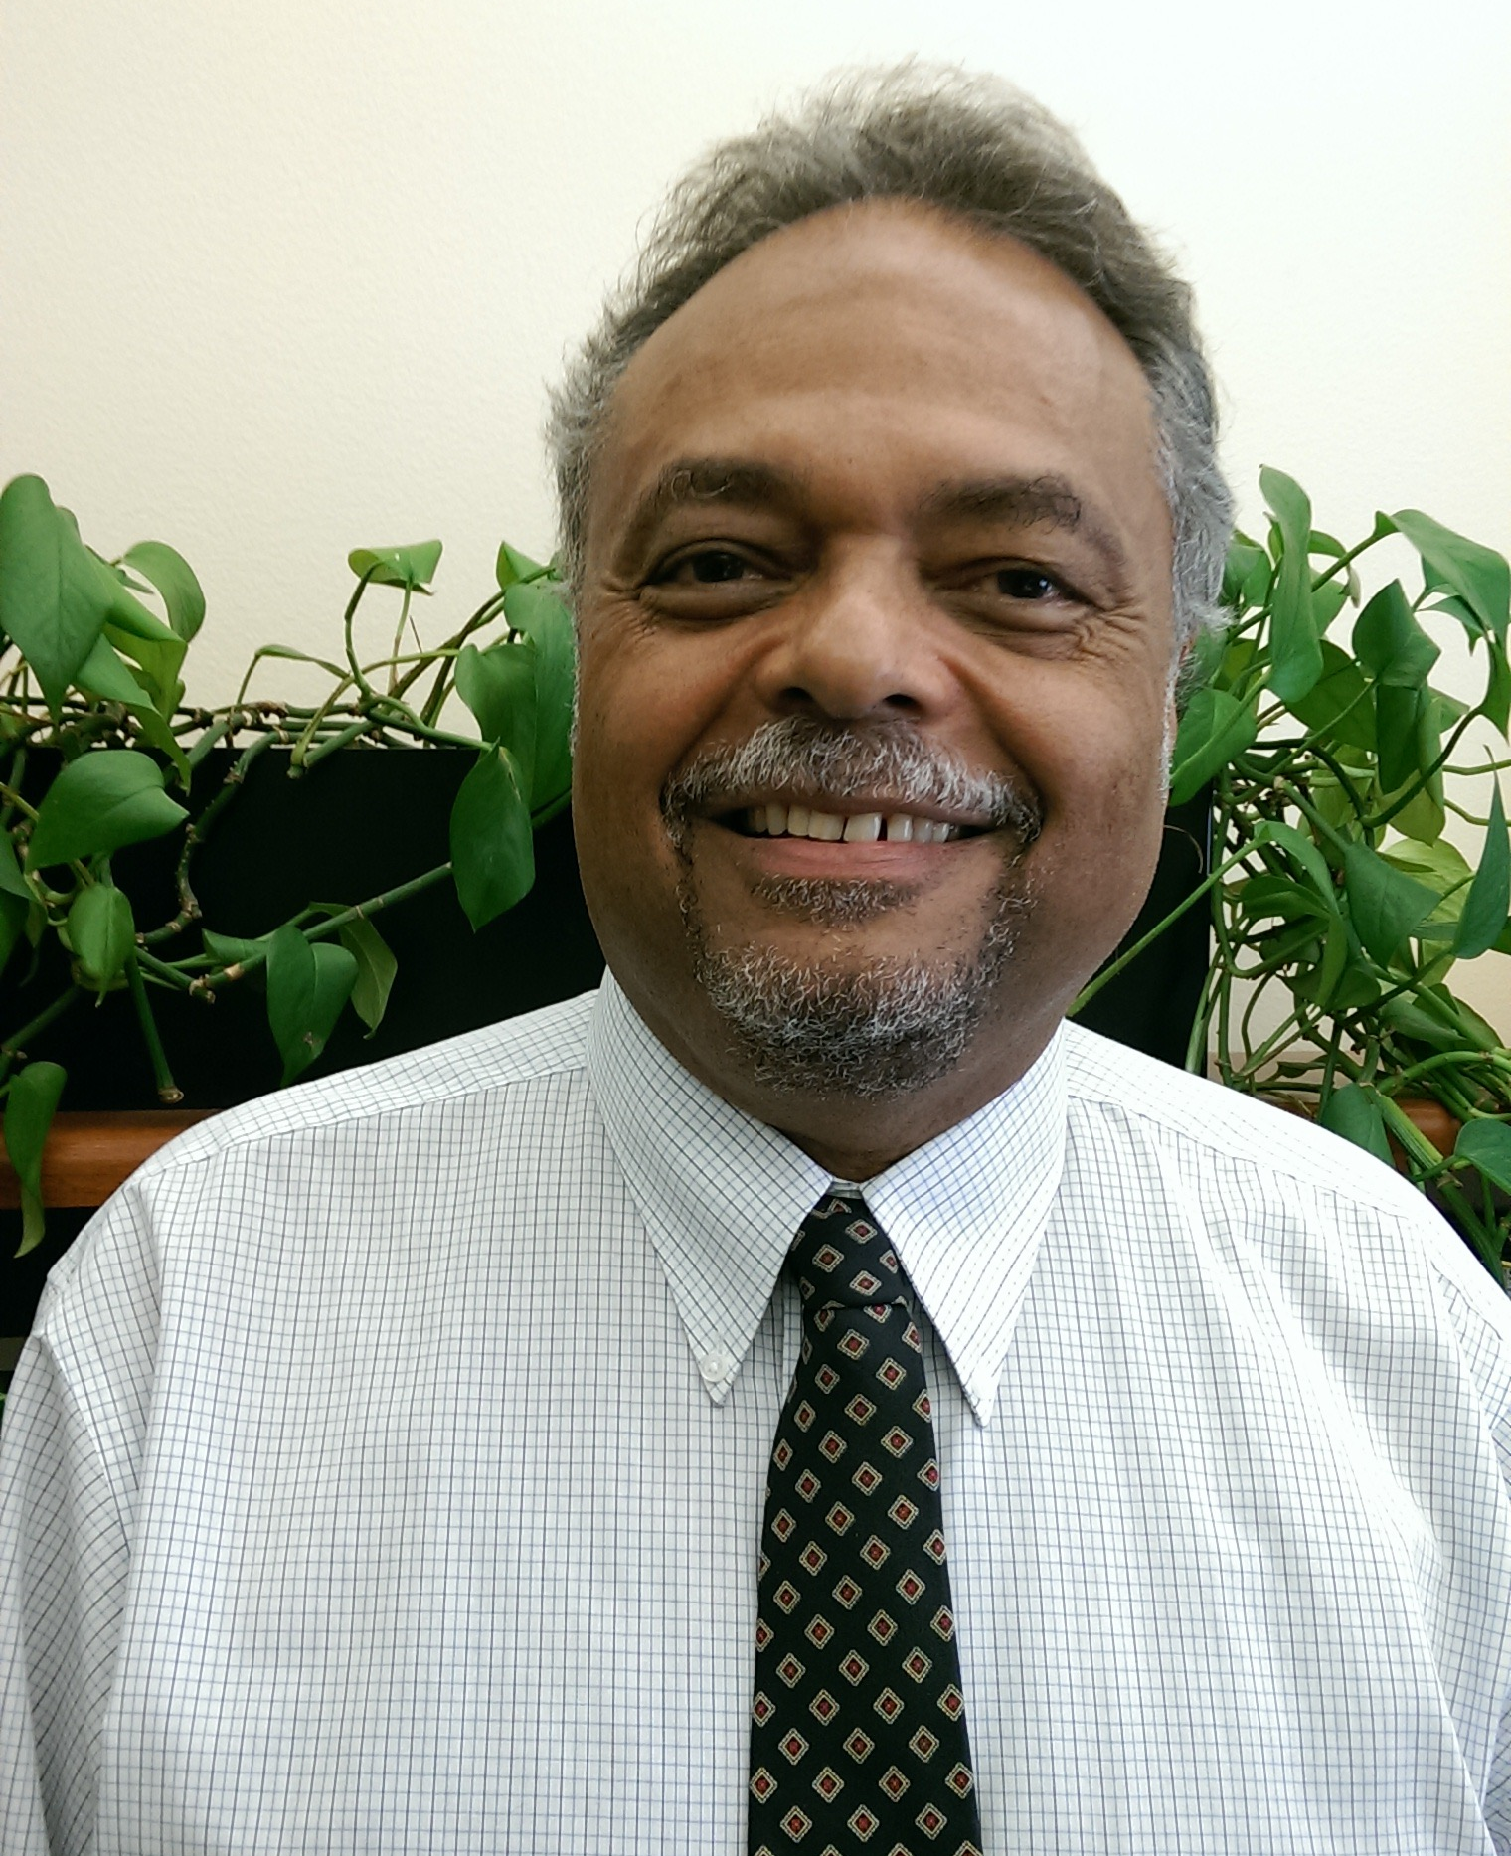
Speaker
Oren J. Henry
Director of Housing and Community Development
City of Orlando, Florida
oren.henry@orlando.gov

Slide 3
Background
The State and Local Fiscal Recovery Funds (SLFRF) program, part of the American Rescue Plan, provides governments across the country with resources to:
Fight the pandemic and support families and businesses struggling with its public health and economic impacts
Maintain vital public services, even amid declines in revenue resulting from the crisis
Build a strong, resilient, and equitable recovery by making investments that support long-term growth and opportunity

Slide 4
Background
Recipients may use SLFRF funds to:
Replace lost public sector revenue
Respond to the far-reaching public health and negative economic impacts of the pandemic
Provide premium pay for essential workers
Invest in water, sewer, and broadband infrastructure
Substantial flexibility is provided for each jurisdiction to meet local needs within these four separate eligible use categories

Slide 5
City of Orlando
Receiving $58 million
Funds must be obligated before December 31, 2024
Projects must be completed and funds spent by December 31, 2026

Slide 6
City of Orlando
After consultation with Treasury Officials, City Officials determined Orlando legally qualifies to use SLFRF to offset reduction in net tax revenue
Leadership determined 100% of SLFRF would go towards addressing community issues

Slide 7
City of Orlando
Distribution Plan is being developed with a focus on supporting the following priorities:
Homelessness
Affordable housing
Broadband access
Economic opportunity
Downtown revitalization

Slide 8
City of Orlando
As SLFRF have now become City General Funds, they have shed the various commitment and expenditure deadlines and other Federal requirements, but will still meet income qualifications

Slide 9
City of Orlando
To date the City has programmed $4 million for initiatives to prevent gun violence and a job training program for people unemployed or underemployed due to COVID-19
Community Violence Intervention Program
RISE Employment & Training Program

Slide 10
City of Orlando
The bulk of the remaining funds will go towards projects, programs and initiatives to address
Homelessness
Affordable housing

Slide 11
City of Orlando
City Staff is working on a formalized plan
Types of projects we are recommending:
Daytime services
Mental health treatment
Affordable housing for single women and families
Hotel conversion to affordable housing
Vacant property acquisition for affordable housing development
Single-family infill homes
Down payment assistance (DPA) and housing counseling
Housing rehabilitation
Notes:
As our formal plan will not be announced until this summer, we cannot disclose specific project details. However, we can discuss the types of projects we are looking at to tackle the issues of homelessness and affordable housing. This includes:

Slide 12
Daytime Services
Funds may be used to renovate existing non-profit facilities to provide:
Access to immediate employment
Medical care via mobile unit
Meals
Laundry
Mail service
Clothing
Coordination for shelter/housing
Case management
Notes:
Funds MAY be used to renovate existing non-profit facilities to provide…

Slide 13
Mental Health Treatment
Funds may be used to renovate existing non-profit facilities to offer residential treatment in a structured and supervised live-in environment, 24/7

Slide 14
Affordable Housing
Funds may be used to develop a new women and children’s facility to provide:
Shelter
Daycare
Kitchen
Cafeteria
Day services

Slide 15
Hotel Conversions
Funds may be provided to private and non-profit entities to convert hotels into affordable housing units including permanent supportive housing

Slide 16
Property Acquisition
Funds may be used to purchase land to facilitate new construction of affordable housing, including:
Acquisition
Demolition
Environmental clean-up

Slide 17
Single-Family Infill Homes
Funds may be used to purchase land to facilitate new construction of single-family infill homes, including:
Acquisition
Demolition
Environmental clean-up
Construction of new infill housing

Slide 18
DPA/Housing Counseling
Funds may be used to provide down payment assistance and housing counseling to eligible, low-income families to purchase homes, including those in a land trust

Slide 19
Housing Rehabilitation
Funds may be used to supplement existing housing rehabilitation programs to:
Increase number of rehabilitated homes
Increase number of repairs, specifically roofs

Slide 20
Items of Importance
Coordination with other financial resources
Administrative accountability
Contingency for overruns
Evaluation

Slide 21
Questions?
Contact: Oren J. Henry orlando.gov/housing oren.henry@orlando.gov
Notes:
CLOSING: This is a once-in-a-lifetime opportunity for us to expand housing opportunities for income constrained residents. While our work will be focused on some of the most vulnerable areas of Orlando, this initiative will positively impact our entire region as this game-changing investment will help free up housing opportunities that otherwise might not be open.

